Slide 1

Remote Login:
TELNET
and
SSH
TCP/IP Protocol Suite
Copyright © The McGraw-Hill Companies, Inc. Permission required for reproduction or display.

Slide 2
OBJECTIVES:
To introduce the TELNET protocol and show how it implements local and remote login.
To discuss options and sub-options used in TELNET and how they are negotiated.
To define out-of-band signaling in TELNET.
To define different modes of operations in TELNET.
To introduce SSH as an alternative to TELNET.
To show how different components of SSH are combined to provide a secure connection over an insecure TCP connection.
To discuss port-forwarding in SSH and how it can be used to provide security for other applications.
TCP/IP Protocol Suite

Slide 3
Chapter
Outline
2.1 TELNET
2.2 Secure Shell (SSH)
TCP/IP Protocol Suite

Slide 4
2-1 TELNET
TELNET is an abbreviation for TErminaL NETwork. It is the standard TCP/IP protocol for virtual terminal service as proposed by ISO. TELNET enables the establishment of a connection to a remote system in such a way that the local terminal appears to be a terminal at the remote system.
TCP/IP Protocol Suite

Slide 5
Topics Discussed in the Section
Concepts
Time-Sharing Environment
Network Virtual Terminal (NVT)
Embedding
Options and Suboption Negotiation
Controlling the Server
Out-of-Band Signaling
Escape Character
Modes of Operation
User Interface
Security Issue
TCP/IP Protocol Suite

Slide 6

Note
TELNET is a general-purpose
client-server application program.
TCP/IP Protocol Suite

Slide 7
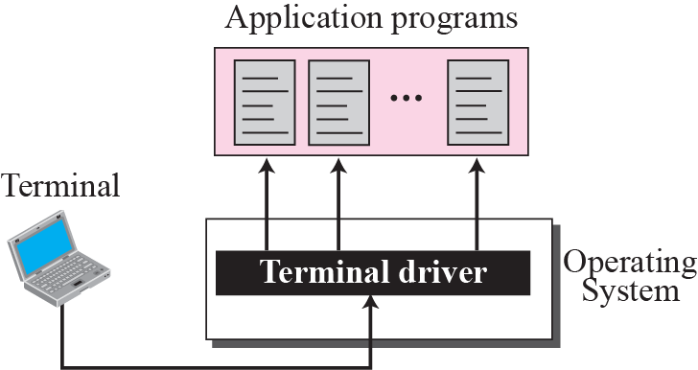
Figure 2.1 Local login
TCP/IP Protocol Suite

Slide 8
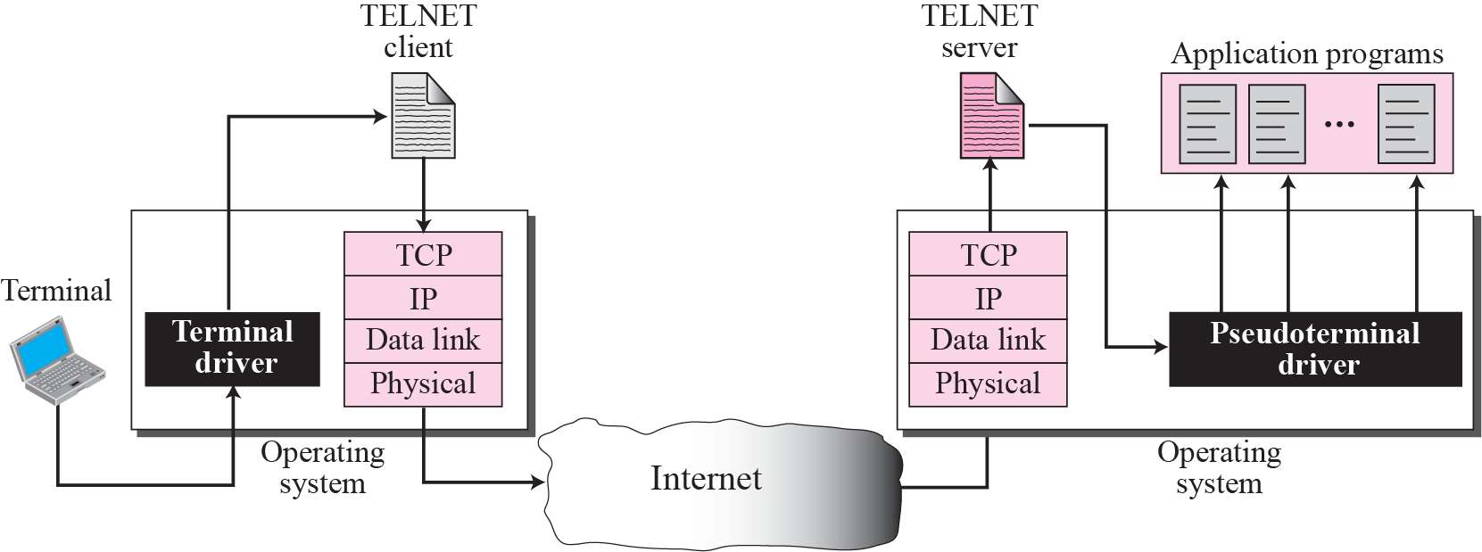
Figure 2.2 Remote login
TCP/IP Protocol Suite

Slide 9
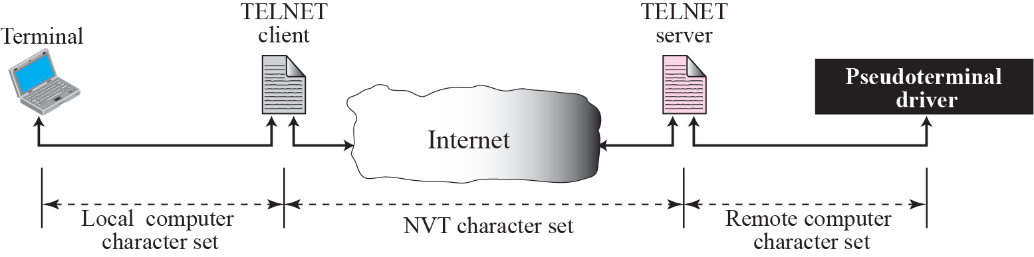
Figure 2.3 Concept of NVT
TCP/IP Protocol Suite

Slide 10
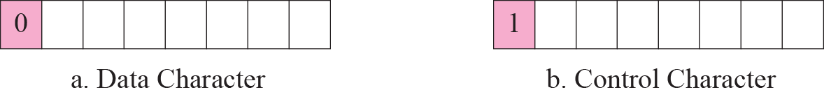
Figure 2.4 Format of data and control characters
TCP/IP Protocol Suite

Slide 11
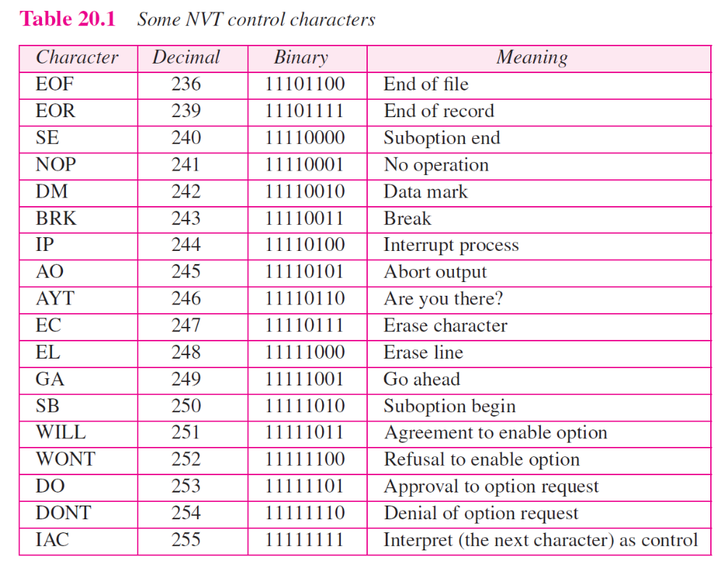
TCP/IP Protocol Suite

Slide 12
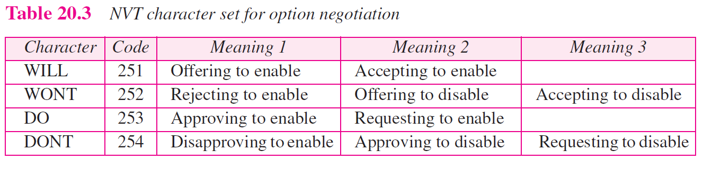
TCP/IP Protocol Suite

Slide 13

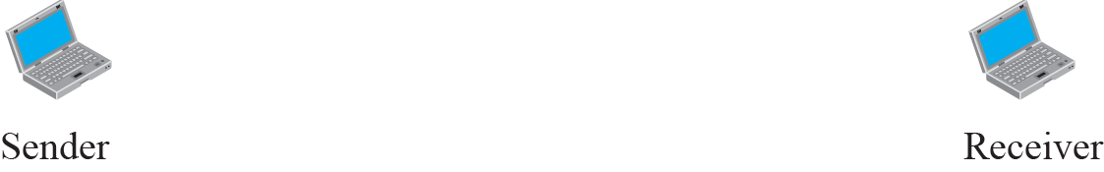

Figure 2.6 Offer to enable an option
TCP/IP Protocol Suite

Slide 14

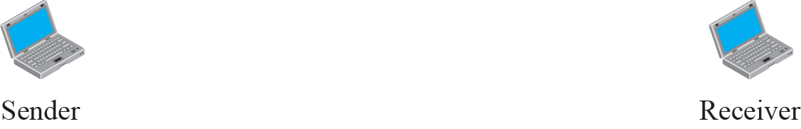

Figure 2.7 Request to enable an option
TCP/IP Protocol Suite

Slide 15


Figure 2.8 Offer to disable an option
TCP/IP Protocol Suite

Slide 16


Figure 2.9 Request to disable an option
TCP/IP Protocol Suite

Slide 17
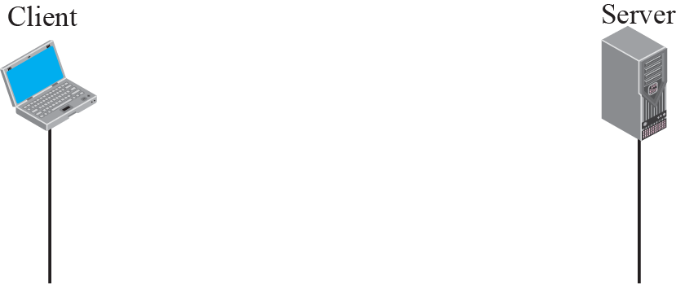
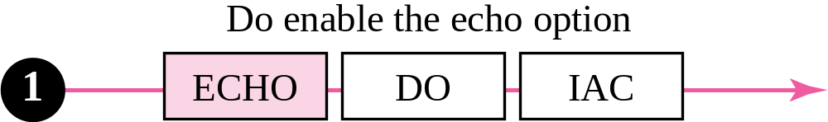
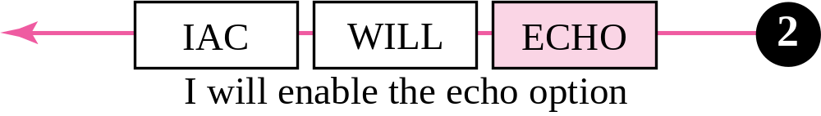
Figure 2.10 Example 20.1: Echo option
TCP/IP Protocol Suite

Slide 18
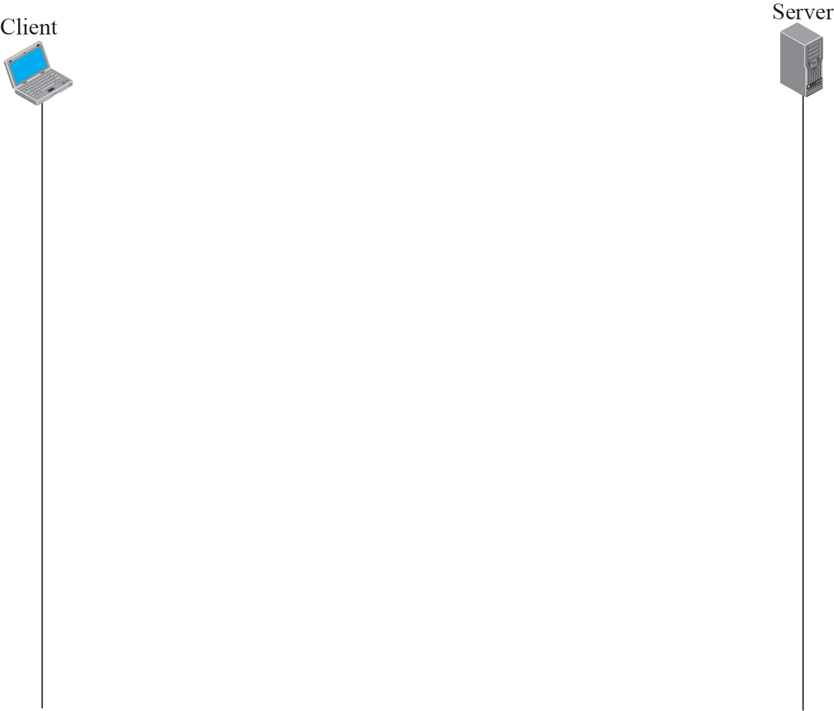
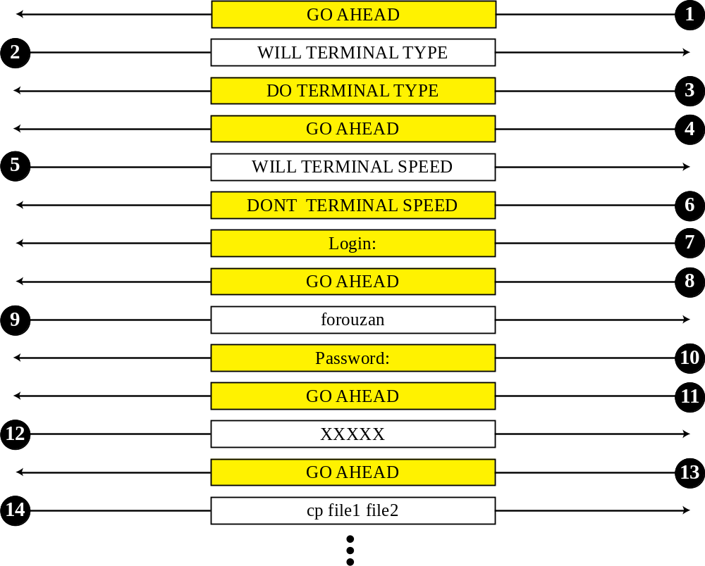
Figure 2.15 Example 20.2
TCP/IP Protocol Suite

Slide 19
2-2 SECURE SHELL (SSH)
Another popular remote login application program is Secure Shell (SSH). SSH, like TELNET, uses TCP as the underlying transport protocol, but SSH is more secure and provides more services than TELNET.
TCP/IP Protocol Suite

Slide 20
Topics Discussed in the Section
Versions
Components
Port Forwarding
Format of the SSH Packet
TCP/IP Protocol Suite

Slide 21
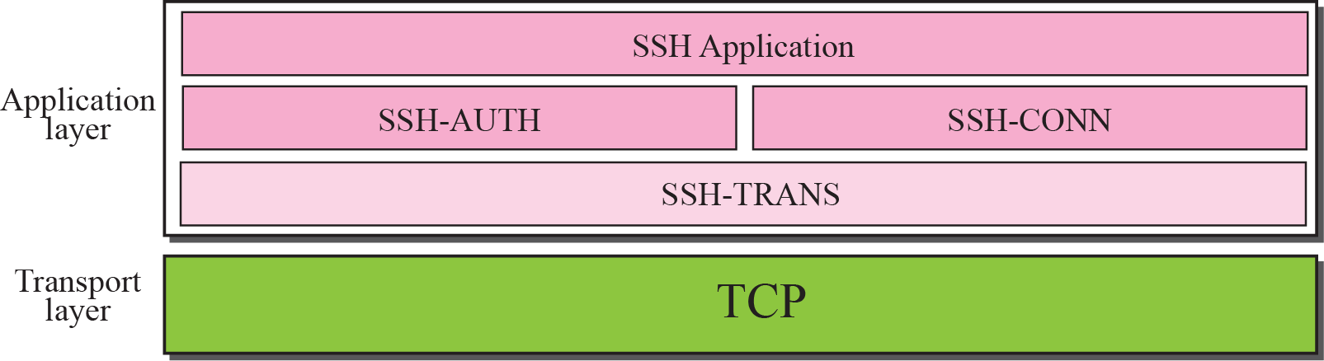
Figure 2.17 Components of SSH
TCP/IP Protocol Suite

Slide 22
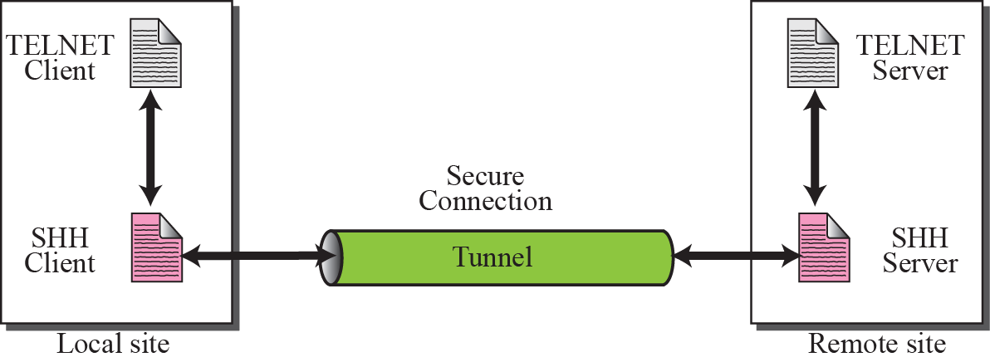
Figure 2.18 Port forwarding
TCP/IP Protocol Suite

Slide 23
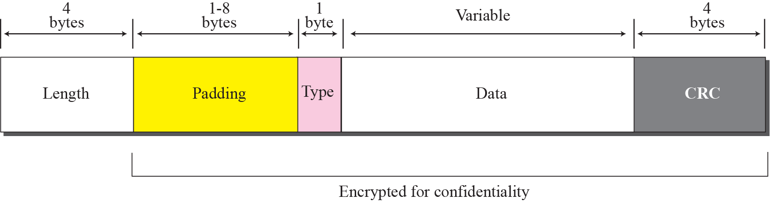
Figure 2.19 SSH packet format
TCP/IP Protocol Suite

